Slide 1
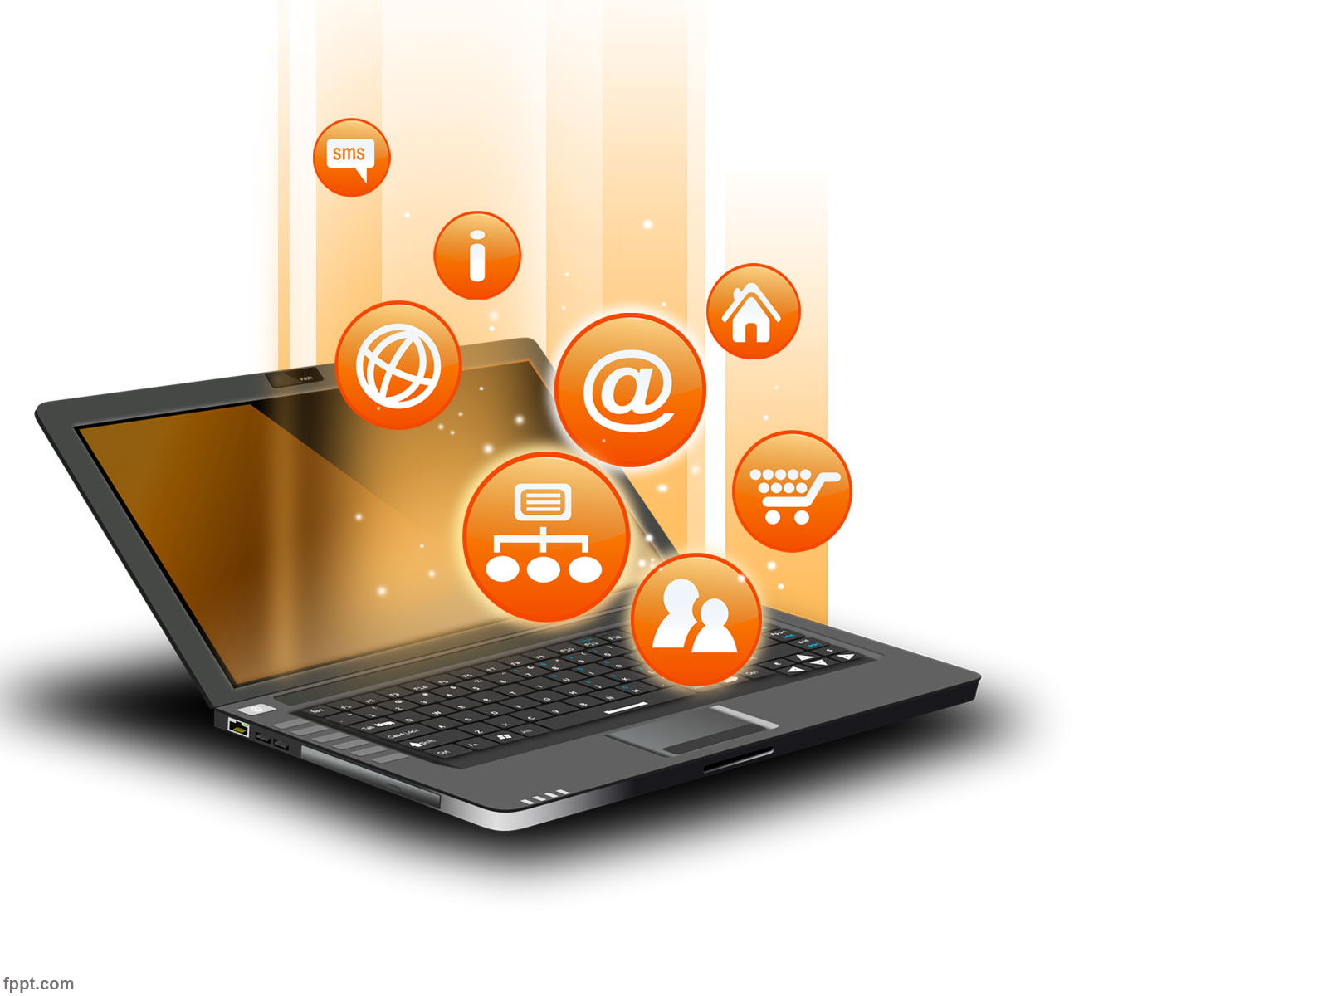
MEDIA AND INFORMATION LITERACY (MIL)
Introduction to Media and Information Literacy
Source:
Mr. Arniel Ping
St. Stephen’s High School
Manila, Philippines
Other online resources through Google
MIL January 2026

Slide 2
MEDIA AND INFORMATION LITERACY (MIL)
Media Literacy
The ability to read, analyze, evaluate and produce communication in a variety of media forms.
Information Literacy
The ability to recognize when information is needed and to locate, evaluate, effectively use and communicate information in its various formats.
Technology (Digital) Literacy
The ability to use digital technology, communication tools or networks to locate, evaluate, use, and create information.
Notes:
What are the similarities and differences of media literacy, information literacy, and technology literacy?
Media literacy, information literacy, and technology literacy are combined together as Media and Information Literacy (MIL)

Slide 3
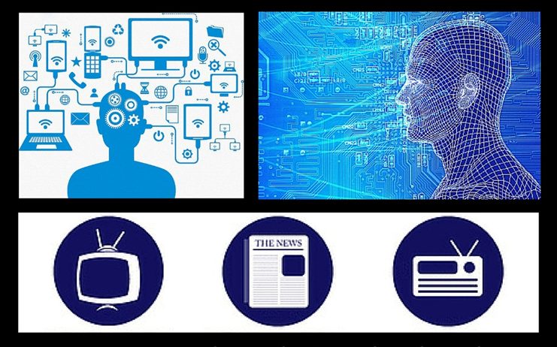
MIL stands for media and information literacy, and refers to the essential competencies and skills that allow citizens to engage with media and other information providers effectively and develop critical thinking and life-long learning skills to socialize and become active citizens. (UNESCO MIL Curriculum for Teachers)

Slide 4
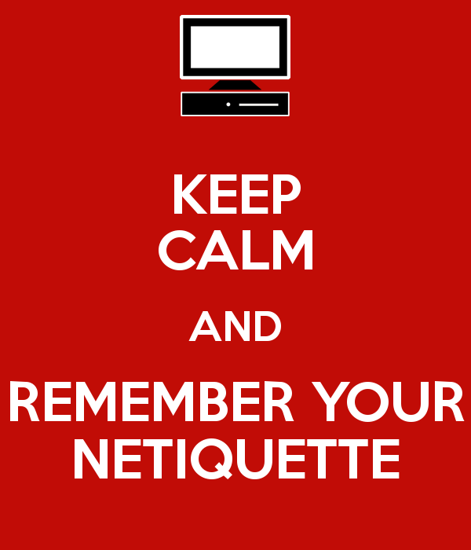
What is the message of this poster?
Do you agree with the message? Why or why not?
Notes:
A media and information literate individual behaves properly on the internet.
The word netiquette is a combination of ’net’ (from internet) and ’etiquette’. It means respecting other users’ views and displaying common courtesy when posting your views to online discussion groups. (http://www.bbc.co.uk/webwise/guides/about-netiquette)

Slide 5
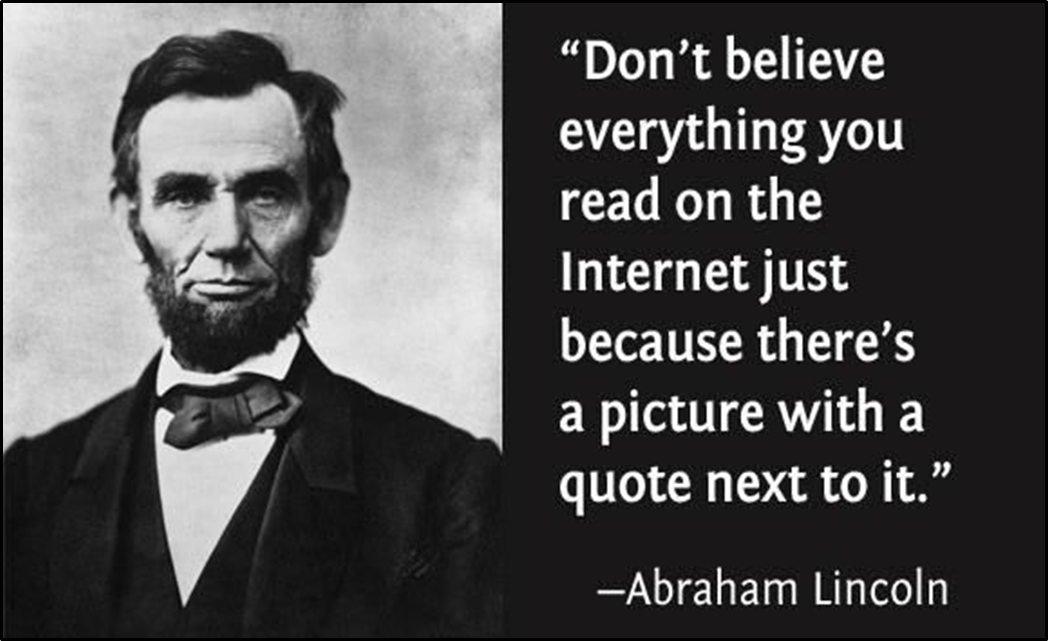
What is the message of this poster?
Do you agree with the message? Why or why not?
Notes:
A media and information literate individual is a critical thinker.
Critical thinking is the ability to think clearly and rationally about what to do or what to believe. It includes the ability to engage in reflective and independent thinking. (http://philosophy.hku.hk/think/critical/ct.php)

Slide 6
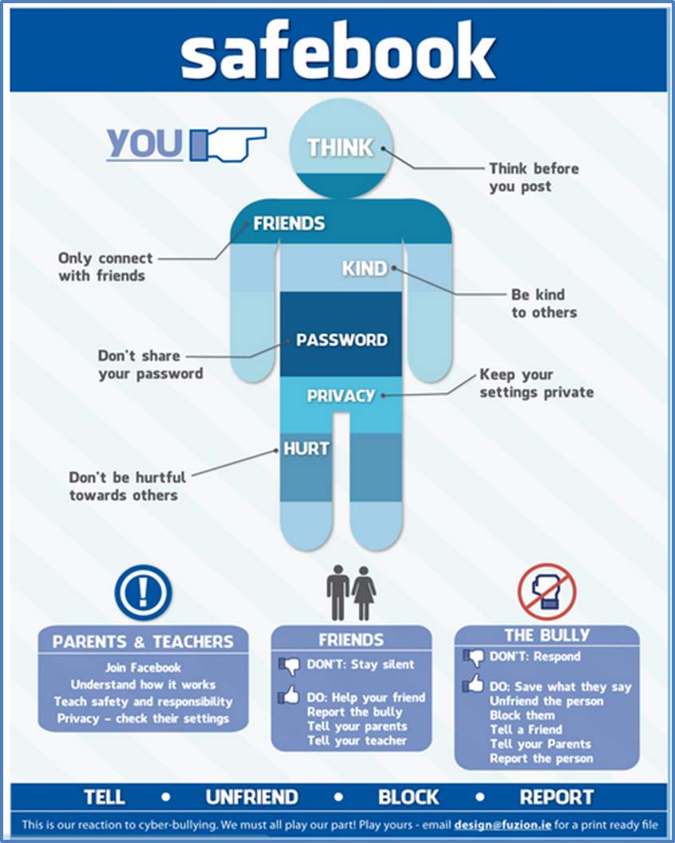
What is the message of this poster?
Do you agree with the message? Why or why not?
Notes:
A media and information literate individual knows how to protect himself/herself and others on the internet?

Slide 7
VIDEO PRESENTATION
Responsible Use of Social Media THINK
by Projonmo Agami
https://www.youtube.com/watch?v=qKxJA7bE-xw
Dos and Don'ts when using social networks
By Information Office
https://youtu.be/vRINOE_ExVY?si=3_XhTKOEKyIcbN5m

Slide 8
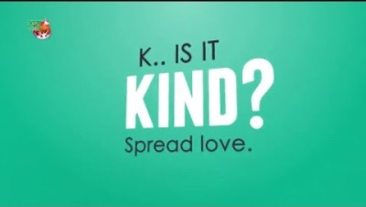

Slide 9
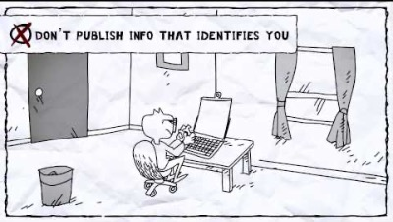

Slide 10
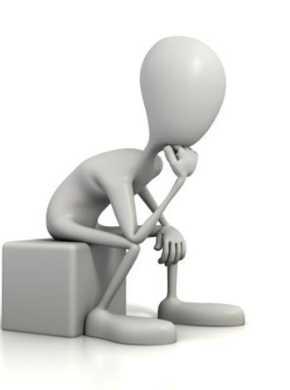
Why is media and information literacy very important?

Slide 11
Importance of Media and Information Literacy
The importance of Media and Information Literacy (MIL) lies in empowering individuals to navigate, analyze, and critically evaluate the vast digital world, combating misinformation, making informed decisions, and participating actively and responsibly in society, fostering both personal growth and democratic resilience in the information age. It moves people from passive consumers to active, discerning creators and users of information, essential for tackling fake news, hate speech, and ensuring informed public discourse. (Online references)
Notes:
What does desensitization mean?

Slide 12
Importance of Media and Information Literacy
Key Benefits of MIL:
Critical Thinking: Develops skills to question, analyze, and assess media messages, identifying bias and intent.
Combats Misinformation: Equips users to spot fake news, disinformation, and propaganda, reducing their spread.
Notes:
What does desensitization mean?

Slide 13
Importance of Media and Information Literacy
Key Benefits of MIL:
Informed Citizenship: Enables better decisions on civic matters, fostering engaged, resilient communities and strengthening democracy.
Digital Safety & Ethics: Teaches how to navigate online spaces safely and create content responsibly, understanding the impact of one's own digital footprint.
Notes:
What does desensitization mean?

Slide 14
Importance of Media and Information Literacy
Key Benefits of MIL:
Personal Empowerment: Enhances communication, supports self-expression, and provides tools for lifelong learning and innovation.
Builds Trust: Fosters understanding of information ecosystems, promoting trust in reliable sources and digital technologies.
Notes:
What does desensitization mean?

Slide 15
Fake News and Fact Checking
What can I do to avoid fake news?
Here's a quick guide to sorting out facts, evaluating resources and becoming more knowledgeable about the resources you use to find information.

Slide 16
Fake News and Fact Checking
Check Credentials - Is the author specialized in the field that the article is concerned with? Does s/he currently work in that field? Check LinkedIn or do a quick Google search to see if the author can speak about the subject with authority and accuracy.
Read the “About Us” section. Does the resource have one? Reputable websites will have some type of About Us section and will provide a way for you to contact them.

Slide 17
Fake News and Fact Checking
Look for Bias - Does the article seem to lean toward a particular point of view? Does it link to sites, files, or images that seem to skew to the left or the right? Biased articles may not be giving you the whole story.
Check the Dates - Like eggs and milk, information can have an expiration date. In most cases, use the most up-to-date information you can find.

Slide 18
Fake News and Fact Checking
Check out the Source - When an article cites sources, it's good to check them out. Sometimes, official-sounding associations are really biased think tanks or represent only a fringe view of a group of people. If you can't find sources, read as much about the topic as you can to get a feel for what's already out there and decide for your self if the article is accurate or not.
Examine URLs - We see quite a bit of domain manipulation these days. For example, what looks like an .edu domain, followed by .co or “lo” is likely a fake or deceptive site. If you are you seeing a slightly variant version of a well-known URL, do some investigating.

Slide 19
Fake News and Fact Checking
Suspect the sensational - When you see something posted that looks sensational, it is even more important to be skeptical. Exaggerated and provocative headlines with excessive use of capital letters or emotional language are serious red flags.
Judge Hard - If what you're reading seems too good to be true, or too weird, or too reactionary, it probably is.
Read for more info: https://utopia.ut.edu/FakeNews/factcheck - s-lg-box-13625239

Slide 20
Plagiarism
In Media and Information Literacy (MIL), plagiarism is presenting someone else's words, ideas, images, or creative work as your own, covering intentional acts like direct copying and unintentional errors like poor paraphrasing, with serious academic and professional consequences, including penalties under laws like the Cybercrime Prevention Act in the Philippines if copyright is involved. It's a key ethical issue, distinct from copyright infringement, that requires citing all sources for text, media, and ideas to maintain integrity and avoid legal trouble.

Slide 21
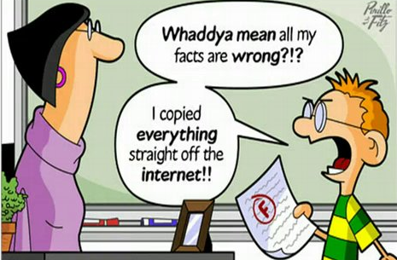

Slide 22
Types of Plagiarism
The Ghost Writer: Submitting another's work word-for-word.
The Photocopy: Copying large sections from one source without changing it.
The Potluck Paper: Mixing text from several sources with minor tweaks.
The Poor Disguise: Slightly changing words or phrases but keeping the original structure.
The Self-Stealer: Borrowing heavily from your own previous work.
Media Plagiarism: Using images, videos, or music from the web without permission or citation.

Slide 23
Why It's a Problem (Consequences)
Academic: Failing grades, suspension, expulsion.
Professional: Damaged reputation, job loss, legal action.
Legal (Philippines): Can fall under copyright infringement, leading to imprisonment and fines under the Cybercrime Prevention Act.

Slide 24
How to Avoid It (Prevention)
Cite Everything: Always credit the original source for words, ideas, and media.
Use Your Own Words: Paraphrase properly, not just by rearranging words.
Document Sources: Keep track of where you find information.
Understand Fair Use: Know when you can use material without permission.

Slide 25
Social Media security and privacy
Social media security and privacy involve protecting your personal data from unauthorized access and misuse, as platforms collect vast amounts of info (posts, location, interests) that can be vulnerable to breaches, scams, identity theft, and oversharing risks.
Key protections include strong, unique passwords, two-factor authentication (2FA), strict privacy settings (limiting audience), being cautious about links/location sharing, and avoiding posting sensitive IDs (passports, bank details) to prevent fraud and stalking. (Online resources)

Slide 26
DepEd Video Lessons
https://youtube.com/playlist?list=PLeSycEi09hln3E_J9Mhu1kve5duqQEu8A&si=TG7mWiFHJXkM0YNT
https://www.youtube.com/watch?v=HzP6IDTMNEA&list=PLymjw6LZq7owvLWOiDpyk-ilVPrOh19ju

